Slide 1
An Overview of Energy Storage Systems (ESS) for Electric Grid Applications
EE 653 Power distribution system modeling, optimization and simulation
GRA: Jinqiang Liu
Advisor: Dr. Zhaoyu Wang
Department of Electrical and Computer Engineering
Iowa State University

Slide 2
Outline
Classification of Energy Storage Technologies
  Mechanical Energy Storage Systems
  Electrochemical Energy Storage Systems
  Chemical Energy Storage Systems
  Electrical Energy Storage Systems
  Thermal Energy Storage Systems
Applications of Energy Storage Systems in Power Grid
  Energy Arbitrage
  Capacity Credit
  Ancillary Services
  Customer Side Beneﬁts
Optimization formulations for battery dispatch
ECpE Department

Slide 3
Outline
Classification of Energy Storage Technologies
  Mechanical Energy Storage Systems
  Electrochemical Energy Storage Systems
  Chemical Energy Storage Systems
  Electrical Energy Storage Systems
  Thermal Energy Storage Systems
Applications of Energy Storage Systems in Power Grid
  Energy Arbitrage
  Capacity Credit
  Ancillary Services
  Customer Side Beneﬁts
Optimization formulations for battery dispatch
ECpE Department

Slide 4

Mechanical Energy Storage Systems
Mechanical ESS utilize different types of mechanical energy as the medium to store and release electricity according to the demand of power systems.
Flywheel ESS store electricity in the form of rotational kinetic energy
  High power density and fast response
  Large initial investment and high rates of energy loss
  Pump hydro ESS store and release energy through two water reservoirs with a considerable vertical height difference
  Good technological maturity and commercial availability
  Adverse environmental impact and geological sitting limitation
  Compressed air ESS utilize the electricity to power compressors to store the energy in the form of compressed air in a vessel, while the energy can be released into a gas turbine to save the use of natural gas.
  Commercial availability for very high power and energy with a single unit
  Difficult to find a suitable geologic storage medium like a hard-rock cavern, salt
  cavern, or aquifer storage)
ECpE Department

Slide 5
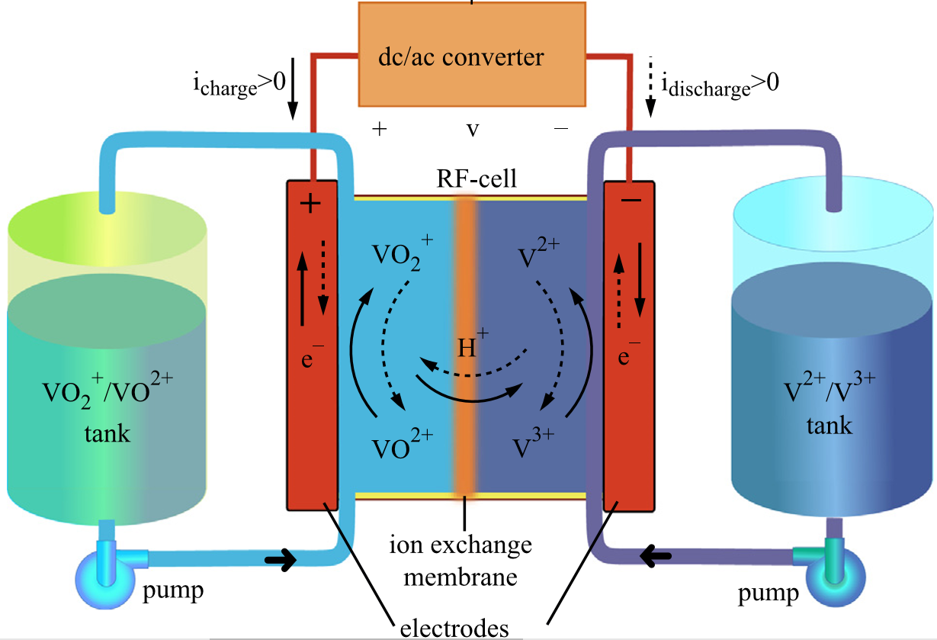
Electrochemical Energy Storage Systems
Energy is transferred between electrical and chemical energy stored in active chemical compounds through reversible chemical reactions.
Flow batteries convert electricity to chemical energy stored in an electrolyte ﬂowing through a reactor and release the energy by the reverse reaction
Alotto, Piergiorgio, Massimo Guarnieri, and Federico Moro. "Redox flow batteries for the storage of renewable energy: A review." Renewable and sustainable energy reviews 29 (2014): 325-335.
ECpE Department

Slide 6
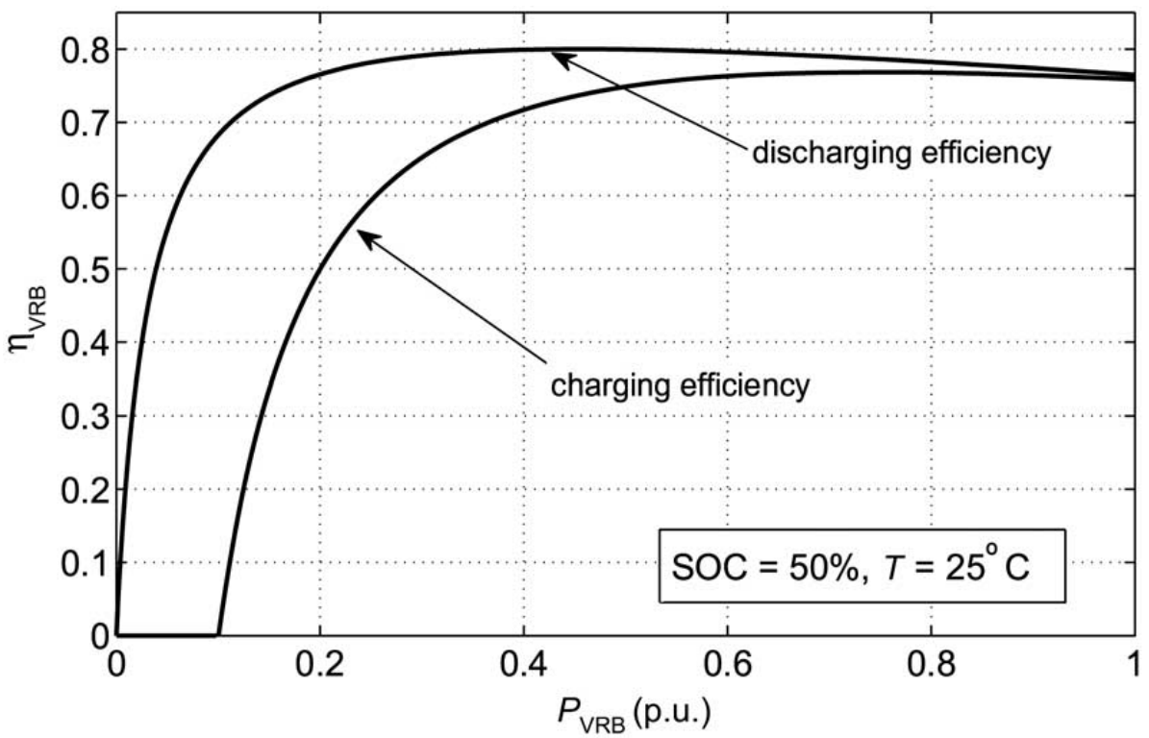
Flow Battery ESS
The vanadium redox flow battery is one of the most popular types of flow batteries
The charge and discharge efficiencies of vanadium redox flow battery varies greatly with the output power
Large capacity of single unit, long cycle life
Environmental impact of toxic ion-exchange membrane, low energy density
  The efficiency initially increase along with the output power and then slightly decrease along with the output power.
  An optimal operation point exist at either charge or discharge operation for the maximal efficiency.
Nguyen, Tu A., Mariesa L. Crow, and Andrew Curtis Elmore. "Optimal sizing of a vanadium redox battery system for microgrid systems." IEEE transactions on sustainable energy 6.3 (2015): 729-737.
ECpE Department

Slide 7
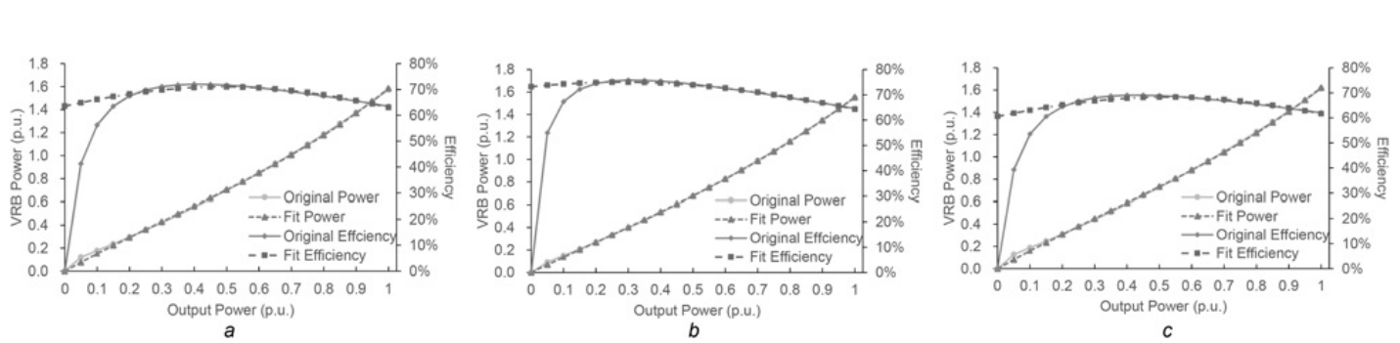
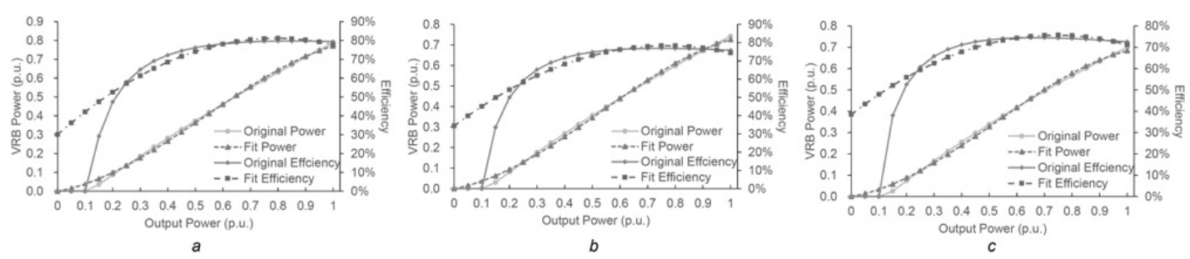
Flow Battery ESS
The charge and discharge efficiencies of vanadium redox flow battery are also dependent on the state of charge (SoC)
discharge
20% SoC
50% SoC
80% SoC
charge
  The battery with 50% SoC possesses a better efficiency curve at the discharge mode
  The battery with 20% SoC possesses a better efficiency curve at the charge mode
He, Guannan, et al. "Optimal operating strategy and revenue estimates for the arbitrage of a vanadium redox flow battery considering dynamic efficiencies and capacity loss." IET Generation, Transmission & Distribution 10.5 (2016): 1278-1285.
ECpE Department

Slide 8
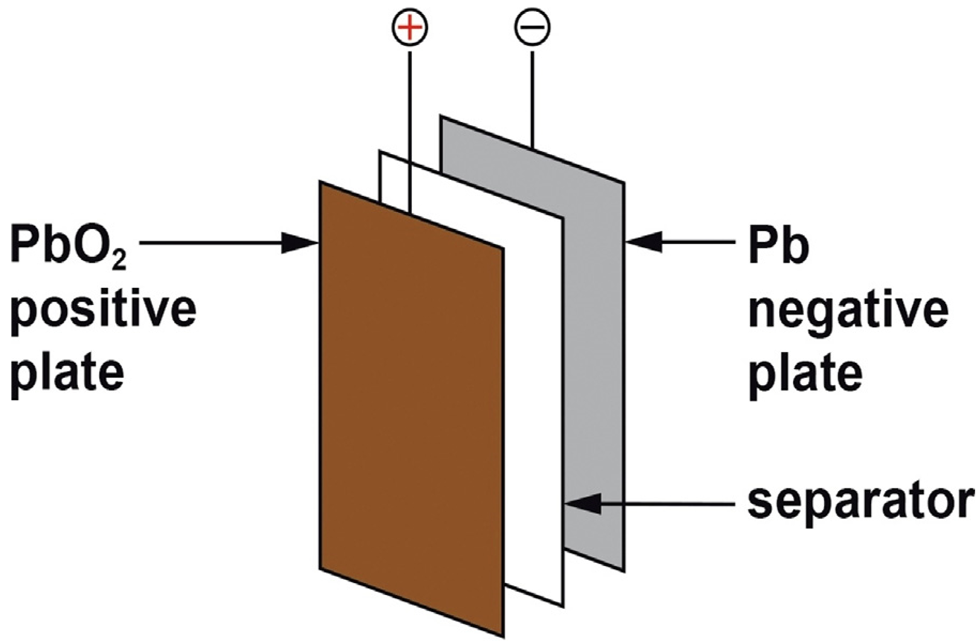
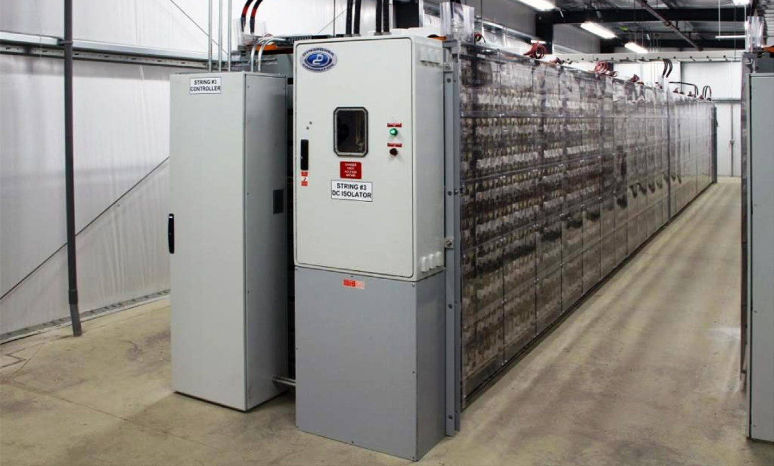
Lead-acid Battery ESS
The lead-acid battery has more than 100-year history like PHES and has been applied to some commercial ESS projects.
Power/Capacity | Location
10 MW/40 MWh | Chino, California
20 MW/14 MWh | Puerto Rico Electric Power Authority Metro
Low cost and high reliability
Low energy density, short cycle life, performance degradation in low temperatures
May, Geoffrey J., Alistair Davidson, and Boris Monahov. "Lead batteries for utility energy storage: A review." Journal of Energy Storage 15 (2018): 145-157.
ECpE Department

Slide 9
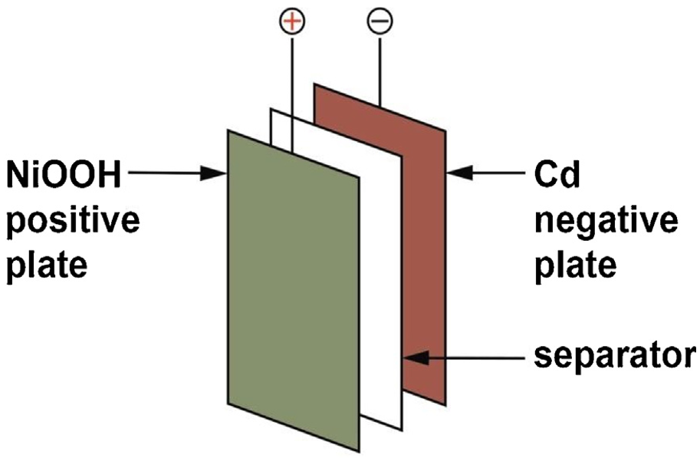
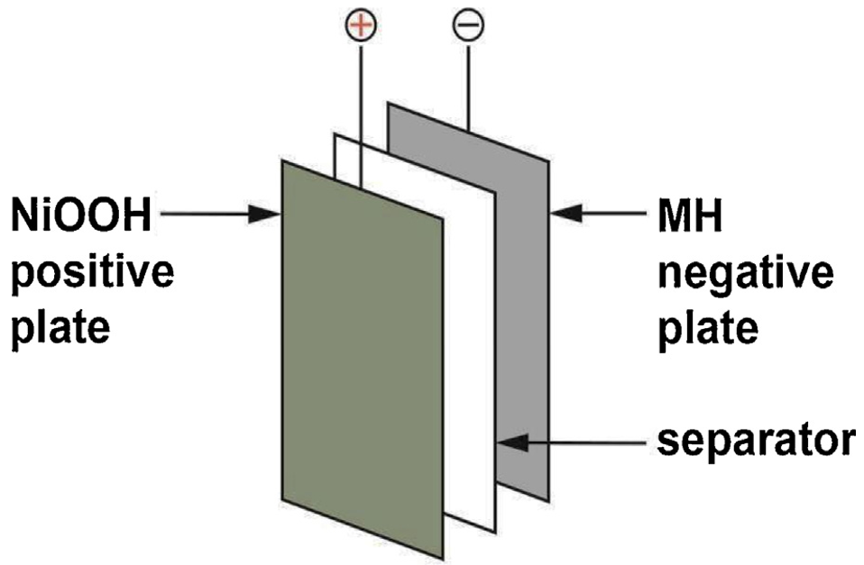
Nickel-based Battery ESS
A nickel hydroxide positive electrode and other active materials as negative electrodes, such as Fe, Cd, Zn, H2, and metal hydrides (MH)
Power/Duration | Location
27 MW/15 mins | Golden Valley Electric Association
3 MW/2 mins | Island of Bonaire (in company with wind energy )
Higher energy density and longer cycle life than the lead-acid battery
Memory effect, high self-discharge, and reduction of power and capacity from overcharge
May, Geoffrey J., Alistair Davidson, and Boris Monahov. "Lead batteries for utility energy storage: A review." Journal of Energy Storage 15 (2018): 145-157.
ECpE Department

Slide 10
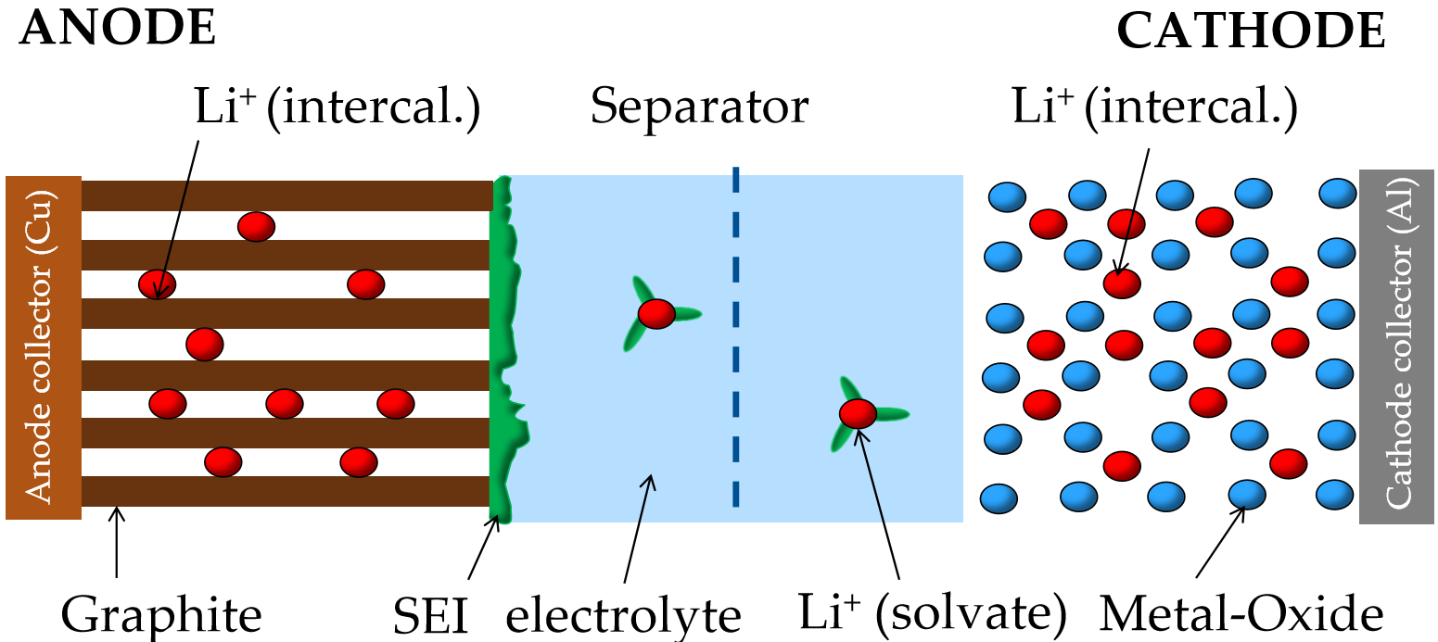
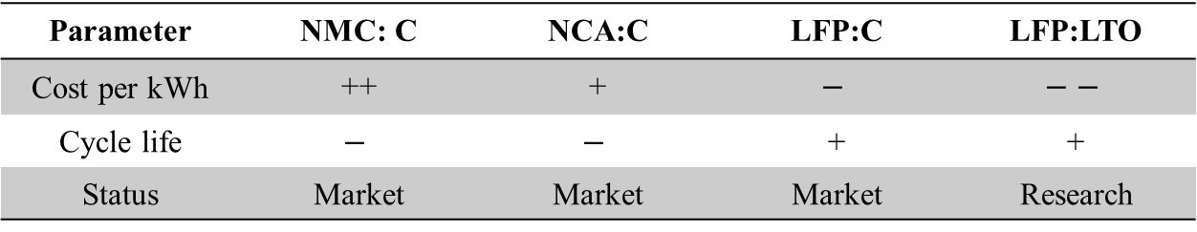
Lithium-ion Battery ESS
Li-ions travel from the cathode to anode through an electrolyte solution while the current ﬂows from the anode to cathode in an external circuit
Parameter | NMC: C | NCA:C | LFP:C | LFP:LTO
Cost per kWh | ++ | + | $$−$$ | $$−−$$
Cycle life | $$−$$ | $$−$$ | + | +
Status | Market | Market | Market | Research
Hesse, Holger C., et al. "Lithium-ion battery storage for the grid—a review of stationary battery storage system design tailored for applications in modern power grids." Energies 10.12 (2017): 2107.
ECpE Department

Slide 11
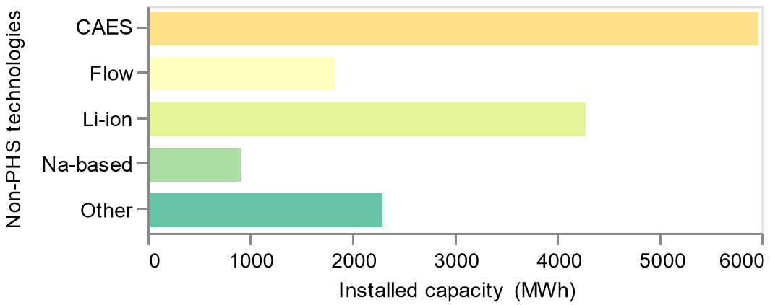
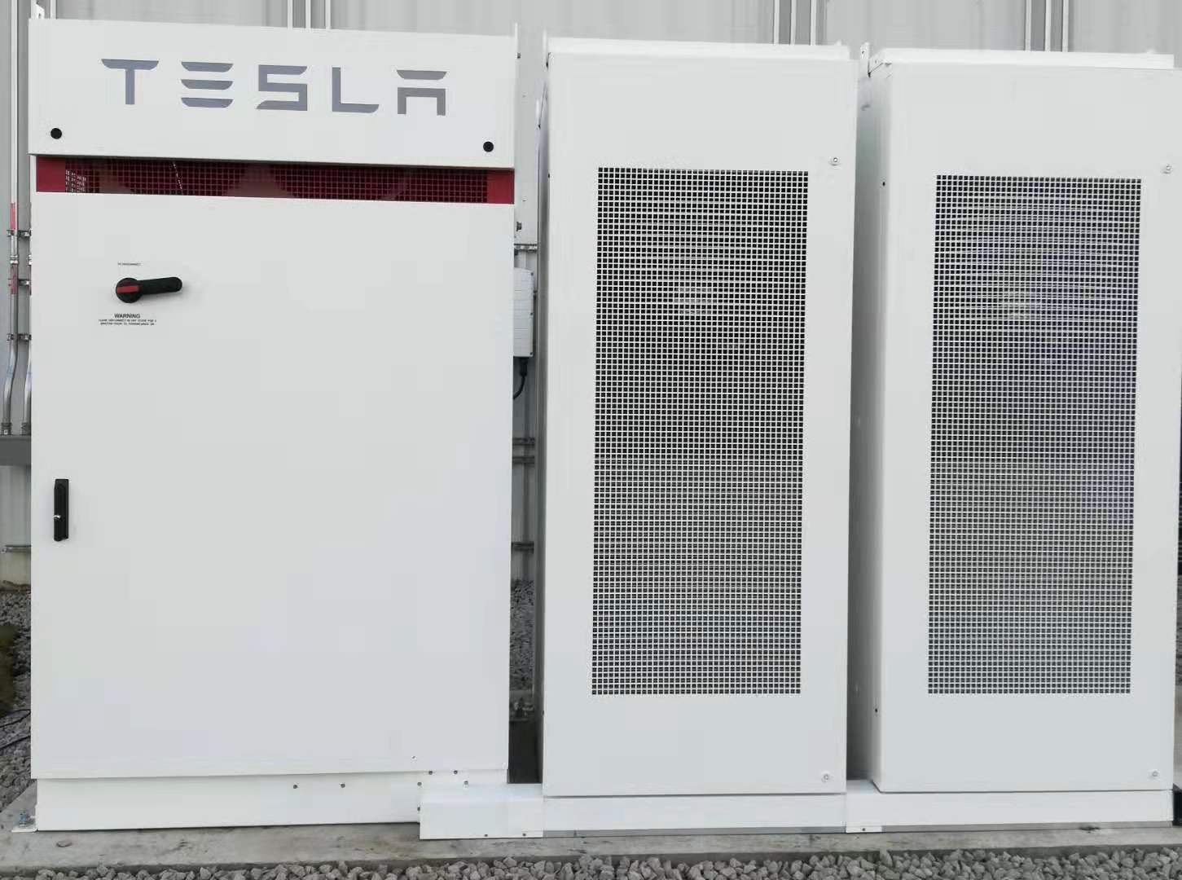
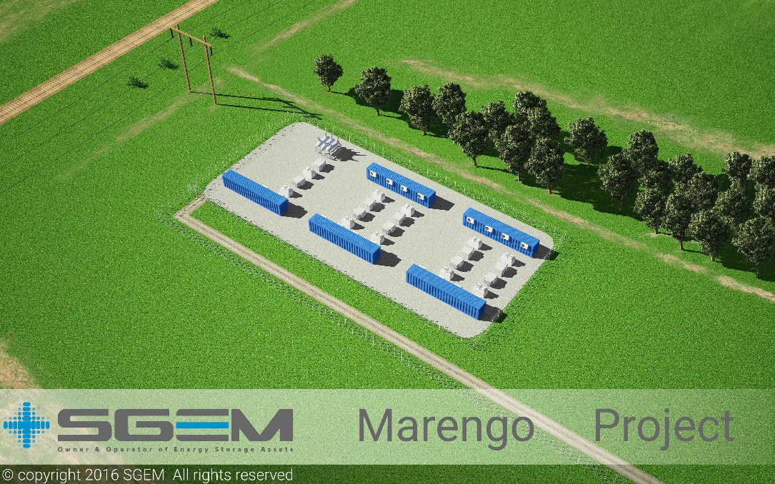
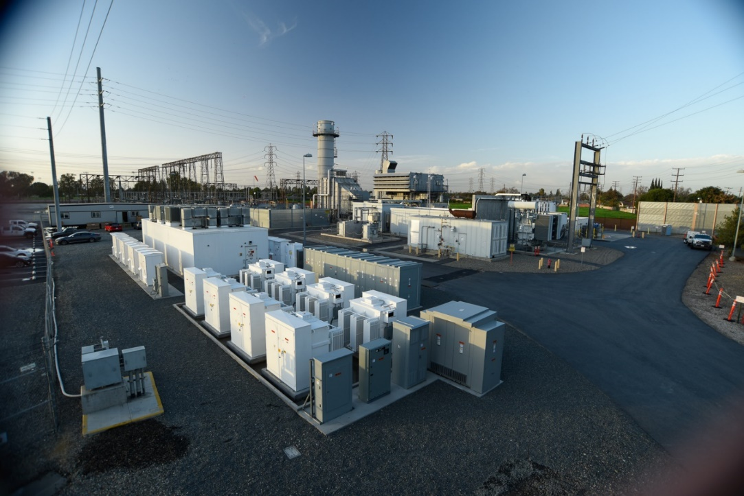
Lithium-ion Battery ESS
Li-ions batteries ESS are increasingly deployed in electric grids
212kW/424kWh
20 MW/10 MWh
10 MW/4.3 MWh
ECpE Department
Meyersdale Energy Storage
Meyersdale Energy Storage

Slide 12
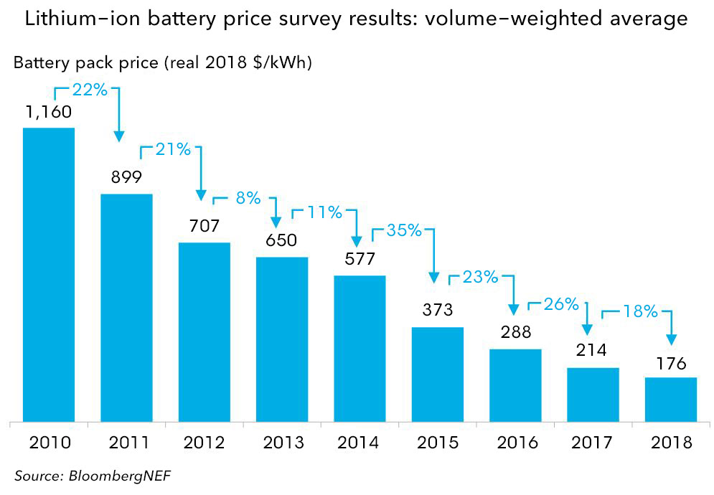
Lithium-ion Battery ESS
Li-ions batteries are an ideal choice for ESS
The costs of Li-ion batteries are expected to continuously decrease
Highest energy density among all electrochemical ESS and long cycle life
High cost and fast aging resulting from deep charge and discharge cycling
ECpE Department
Meyersdale Energy Storage
Meyersdale Energy Storage

Slide 13
Chamber 1 (30°C)
Chamber 2 (55°C)
Panasonic 18650 cells
Lithium-ion Battery ESS
Panasonic 18650 cells aging test
Higher depth of cycle $∆DoD$ accelerates the battery capacity degradation
Higher temperature T also accelerates the battery capacity degradation
ECpE Department

Slide 14
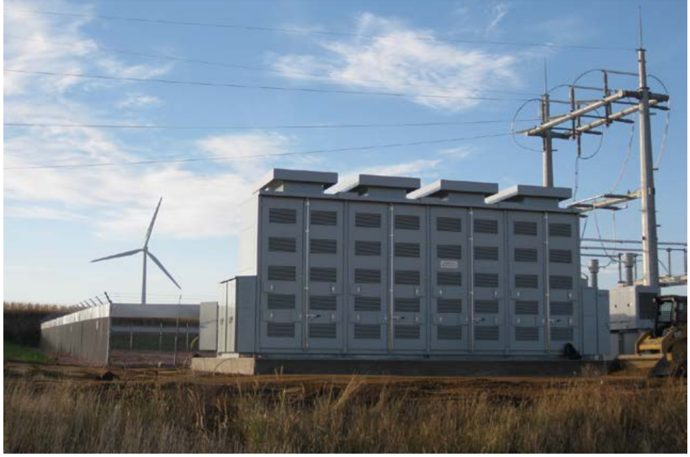
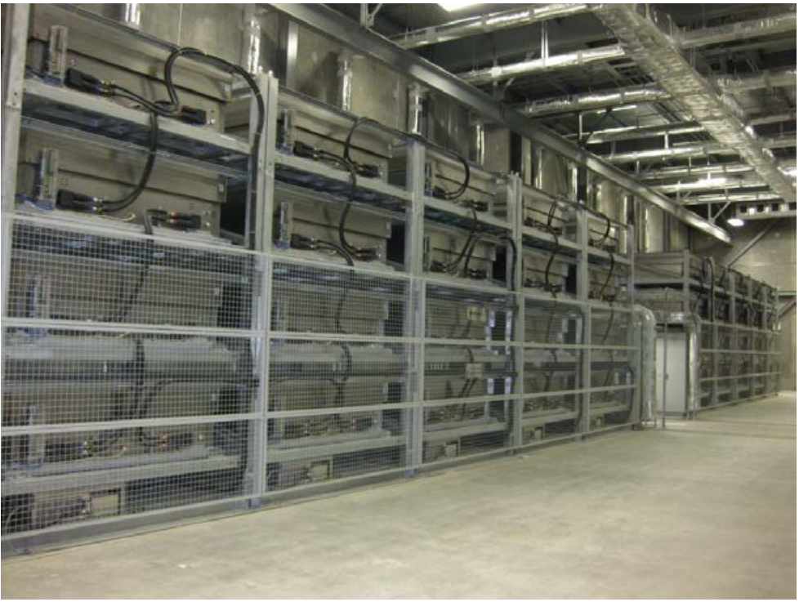
Sodium-ion Battery ESS
Sodium-beta batteries use sodium (Na) as the anode material. They are distinguished from other batteries due to their solid electrolyte beta-alumina.
High power and energy density and long cycle life
High operation temperature at about 350 °C, high internal resistance, and Na
erosion
1 MW NAS Battery System installed in Luverne, MN
4 MW NAS Battery installation at Presidio, TX
ECpE Department
Meyersdale Energy Storage
Meyersdale Energy Storage

Slide 15
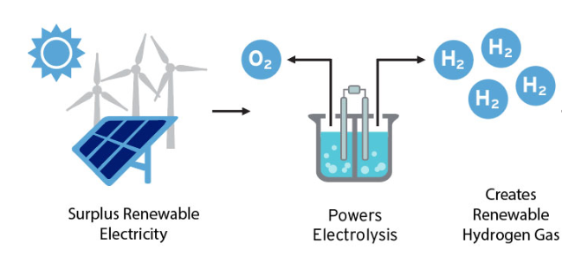
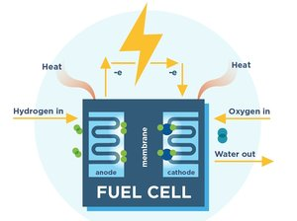
Chemical Energy Storage Systems
Chemical energy storage systems (CESS) generate electricity through some chemical reactions releasing energy.
Unlike electrochemical storage technology, the fuel and oxidant are externally supplied and need to be reﬁlled for recycling in a fuel cell.
  CESS have largely been developed using hydrogen due to its excellent characteristics as fuel and its very high energy density
  However, the high cost and low efficiency place critical limitations for the broad applications of hydrogen fuel cells.
http://www.fchea.org/in-transition/2019/7/22/unlocking-the-potential-of-hydrogen-energy-storage
ECpE Department

Slide 16
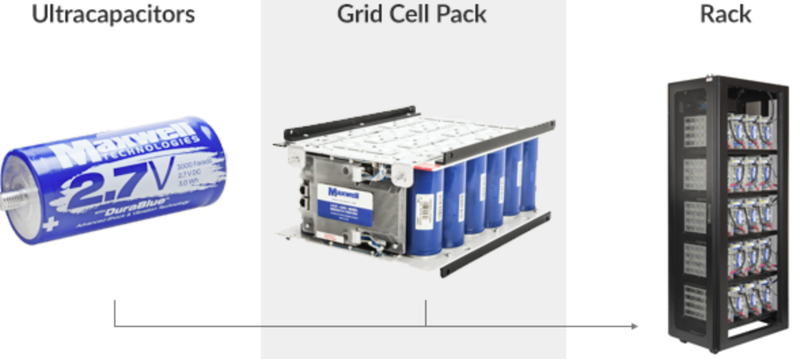
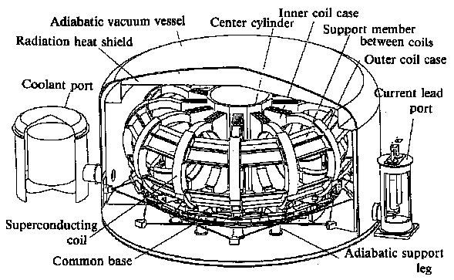
Electrical Energy Storage Systems
Ultra-capacitors (UC) have high power density, 95% efﬁciency, and long lifetime, but suffer from high self-discharge rate and high cost.
  Many researchers are currently developing nanostructured materials to improve the performance of UC.
  Superconducting magnetic energy storage systems(SMESS) store electricity in the magnetic ﬁeld through a large current circulating in a superconducting coil.
  Current studies focus on reducing the cost of coils and temperature control system.
https://www.maxwell.com/products/ultracapacitors/grid-cell-pack
http://www.wtec.org/loyola/scpa/02_06.htm
ECpE Department

Slide 17
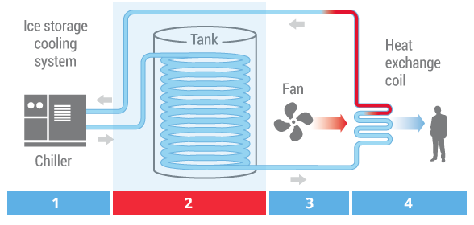
Thermal Energy Storage Systems
Thermal energy storage systems (TESS) store energy in the form of heat for later use in electricity generation or other heating purposes.
Depending on the operating temperature, TESS can be categorized into two groups: low-temperature (<200 °C) TESS and high-temperature TESS.
High-temperature TESS can be further categorized into three sub-groups: latent heat, sensible heat, and thermal-chemical sorption storage systems.
http://www.calmac.com/how-energy-storage-works
ECpE Department

Slide 18
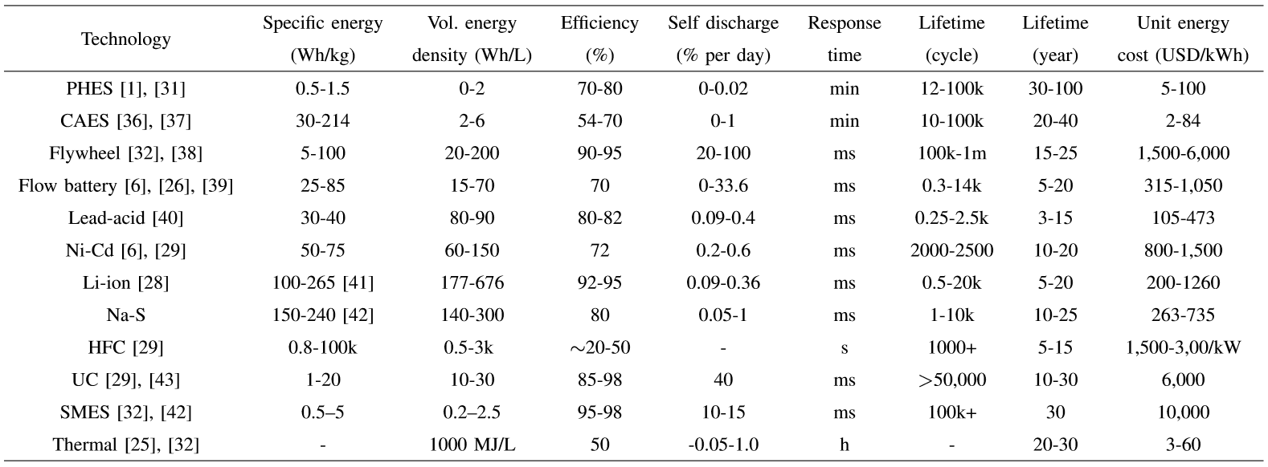
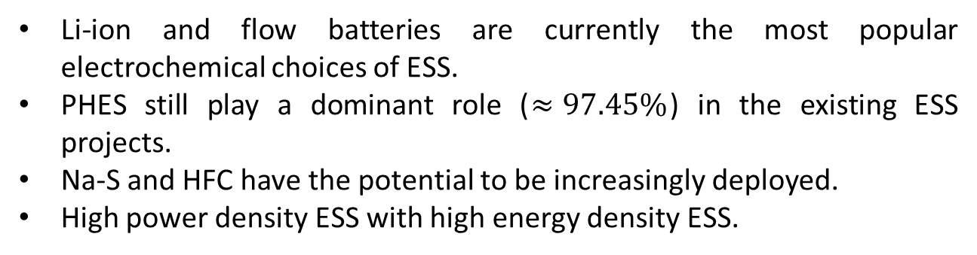
Comparison of Energy Storage Technologies
Li-ion and flow batteries are currently the most popular electrochemical choices of ESS.
PHES still play a dominant role ($≈97.45\%$) in the existing ESS projects.
Na-S and HFC have the potential to be increasingly deployed.
High power density ESS with high energy density ESS.
ECpE Department

Slide 19
Formulations of Energy Storage Technologies in Power Grids
Technology | Power limit | Ramp limit | Energy limit | Efficiency | Lifetime
Pump | ✓ | ✓ | ✓ | ✓ | fixed
Flow battery | ✓ | ✗ | ✓ | function of power and energy | function of operations
Li-ion | ✓ | ✗ | ✓ | ✓ | function of operations
Thermal | ✓ | ✓ | ✓ | ✓ | fixed
Traditional pump hydro and thermal storage technologies take relatively longer time to increase or decrease, which necessitate the ramp limits.
Flow battery’s formulation will introduce dynamic efficiency constraints.
For electrochemical battery, especially Li-ion, lifetime is dependent on the operation.
ECpE Department

Slide 20
Outline
Classification of Energy Storage Technologies
  Mechanical Energy Storage Systems
  Electrochemical Energy Storage Systems
  Chemical Energy Storage Systems
  Electrical Energy Storage Systems
  Thermal Energy Storage Systems
Applications of Energy Storage Systems in Power Grid
  Energy Arbitrage
  Capacity Credit
  Ancillary Services
  Customer Side Beneﬁts
Optimization formulations for battery dispatch
ECpE Department

Slide 21
Classification of ESS Applications
Based on the physical locations in the grid, ESS can be categorized into two groups: in front of the meter and behind the meter.
ESS in front of the meter can be further divided into transmission and distribution subgroups.
ESS behind the meter can be further divided into non-residential and residential subgroups.
ESS service scopes can be categorized into four groups: wholesale market, transmission, distribution, and customer.
ESS located at the lower hierarchical levels of the grid could potentially provide services for the higher hierarchical levels of the grid.
Some services at these higher levels may be unavailable due to specific performance requirements or direct control by the utility.
ECpE Department

Slide 22
Classification of ESS Applications
 |  |  | Grid domain
 |  |  | Transmission | Distribution | Consumer
Power rating (MW) |  |  | 10s ~100s | 0.010~10 | 0.002~2
Service scope | Wholesale | Energy arbitrage
 |  | Frequency regulation
 |  | Reserve
 |  | Resource adequacy
 |  | Demand response
 | Transmission | Transmission deferral
 |  | Voltage support
 |  | Inertia
 |  | Frequency response
 |  | Black start
 | Distribution | Distribution deferral
 |  | Voltage support
 |  | Reliability service
 |  | Microgrid
 | Consumer | Bill reduction
 |  | Increase PV consumption
 |  | Backup power
Various grid applications of ESS that contribute to the increasing integration and consumption of renewable energy.
For example, the voltage support and frequency regulation could alleviate the negative impact resulting from volatile power generated by the renewable energy sources.
ECpE Department

Slide 23
Classification of ESS Applications
Grid applications of ESS
Consumer side benefits
Ancillary service
Energy arbitrage
Electric supply
capacity credits
Electricity bill
reduction
Increase of PV consumption
Back-up power
Resource adequacy
Price-taker
Price-maker
Utility-scale
peak shaving
Transmission and distribution deferral
Transmission congestion relief
Frequency support
Spinning and
non-spinning reserve
Voltage support
Black start
Market-based
regulation
Frequency control
Load demand
ESS applications are also distinguished with each other from their working principles for gaining benefits.
Energy-market based applications focus on the utilization of ESS stored and released energy.
Capacity-related applications include resource adequacy, utility-scale peak shaving, infrastructure deferral, and transmission congestion relief.
Ancillary services mostly make use of the fast, directional, active and reactive power regulation of ESS.
Customer side benefits consist of economic and environmental-friendly components.

Slide 24
Energy Arbitrage
Energy arbitrage using ESS generally involves the purchase of cheap energy from the wholesale energy market for charging the ESS.
Energy arbitrage is readily available for ESS interconnected to the transmission and distribution domain.
Energy arbitrage can be realized by using many storage technologies without technical difﬁculties.
The arbitrage algorithms can be divided into two groups by assuming ESS to be either a price taker or a price maker.
It is difficult for battery storage systems to achieve cost-effective goal by solely implementing the energy arbitrage under the current battery storage costs and energy market conditions.
ECpE Department

Slide 25
Electric Supply Capacity Credit
Capacity credit describes the ability of ESS to defer or reduce the need for upgrading existing generation, transmission, and distribution components that are used to supply peak demand and maintain system reliability
To satisfy the increasing need for peaking capacity, the simple cycle combustion turbine is usually a default choice in the U.S. However, ESS are more efﬁcient for shaving peak load due to its fast response, high energy efﬁciency, and inherent bidirectional power ﬂow.
total load
charge
total load
discharge
discharge
charge
Power demand
Power demand
shaved peak
shaved valley
leveled load
charge
0
3
6
9
12
15
18
21
0
3
6
9
12
15
18
21
Time (Hour)
Time (Hour)
ECpE Department

Slide 26
Resource adequacy
ESS can also earn profits from the wholesale capacity market by providing resource adequacy.
Some capacity markets deﬁne the qualifying capacity of the ESS to be the maximum power rate at which the ESS can continuously discharge for four hours.
Resource adequacy is extremely important for maintaining power system reliability. Therefore, ESS offering resource adequacy capacity is subject to a must-offer obligation in the California Independent System Operator (CAISO).
Large ESS installed in front of the meter currently participate in the CAISO capacity market in the form of a non-generator resource (NGR) model that allows it to extract energy from the grid.
For ESS behind the meter, it can provide resource adequacy in the form of a demand response participation model.
ECpE Department

Slide 27
Transmission and distribution deferral
By effectively reducing peak loading, ESS defer investment for additional transmission and distribution capacity and extend the useful life of existing infrastructures.
A probability method is proposed to quantify the beneﬁts of the combination of ESS and real time thermal rating(RTTR) on deferring or preventing network reinforcement [1].
The optimal deployment of ESS is presented in [2] for the deferral of distribution feeder upgrade. Several important factors that inﬂuence the deferral cost savings are studied, such as the cost of battery and feeder upgrade, and the annual rate of load increase.
[1] Greenwood, David M., et al. "A probabilistic method combining electrical energy storage and real-time thermal ratings to defer network reinforcement." IEEE Transactions on Sustainable Energy 8.1 (2016): 374-384.
[2] T. Zhang, A. E. Emanuel, and J. A. Orr, “Distribution feeder upgrade deferral through use of energy storage systems,” in Power and Energy Society General Meeting (PESGM), 2016. IEEE, 2016, pp. 1–5.
ECpE Department

Slide 28
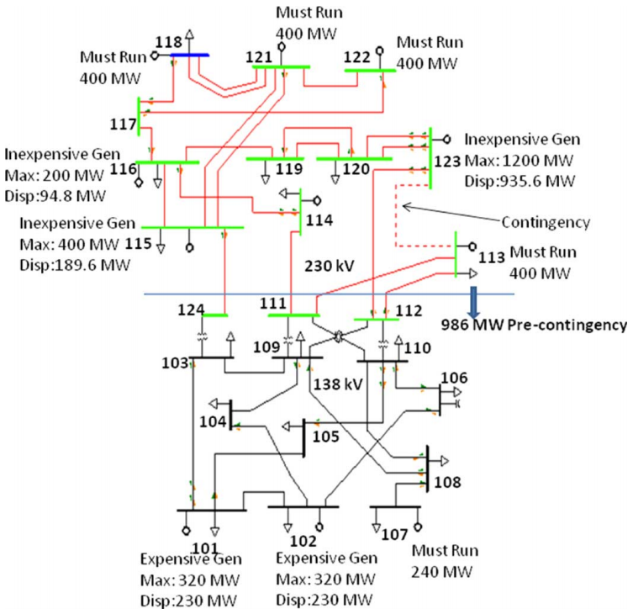
Transmission congestion relief
A survey of different ESS applications on transmission systems is presented in [1]
The continuation method is used to gradually increase the amount of transfer power to the thermal limits of transmission paths, including the overload of a line, transformer or a substation component.
A sensitivity analysis and analytic hierarchical process model are combined to ﬁnd the best locations of ESS to reduce the power ﬂow of critical components.
Application | Description
Oscillation Damping | Improving long-term dynamic stability performance of power system (Small signal stability)
Transient Voltage Dip Improvement | Reduce the transient voltage dip following a system disturbance
Dynamic Voltage Stability | Improve voltage stability margin (Nonlinear system structural stability)
Sub-Synchronous Resonance Damping | Allow high levels of series compensation without arising resonance.
Thermal overload relief | Relief transmission thermal overload and N-1 contingency violations
[1] A. D. Del Rosso and S. W. Eckroad, “Energy storage for relief of transmission congestion,” IEEE Transactions on Smart Grid, vol. 5, no. 2, pp. 1138–1146, 2014.
ECpE Department

Slide 29
Transmission congestion relief
A MILP based real-time optimal dispatch algorithm is proposed in [1] to maximize its arbitrage proﬁt while penalizing the power deviations from congestion relief commands. However, the ﬁnancial beneﬁts of ESS’ contribution to transmission congestion relief have not been clearly quantified.
Further, an adaptive penalty factor is used to achieve the highest possible contribution to congestion relief [2].
ESS are proposed to be an alternative to transmission upgrades by absorbing excess wind energy during a congested period and releasing it when the power ﬂow decreases [3].
The dynamic interactions among wind curtailment, ramp rates of generating plants, and ESS are illustrated in [4].
[1] H. Khani and R. D. Zadeh, “Energy storage in an open electricity market with contribution to transmission congestion relief,” in PES General Meeting— Conference & Exposition, 2014 IEEE. IEEE,2014, pp. 1–5.
[2] H. Khani, M. R. D. Zadeh, and A. H. Hajimiragha, “Transmission congestion relief using privately owned large-scale energy storage systems in a competitive electricity market,” IEEE Transactions on Power Systems, vol. 31, no. 2, pp. 1449–1458, 2016.
[3] M. Korpaas, A. T. Holen, and R. Hildrum, “Operation and sizing of energy storage for wind power plants in a market system,” International Journal of Electrical Power & Energy Systems, vol. 25, no. 8, pp. 599– 606, 2003.
[4 ] L. S. Vargas, G. Bustos-Turu, and F. Larra´ın, “Wind power curtailment and energy storage in transmission congestion management considering power plants ramp rates,” IEEE Trans. Power Syst, vol. 30, no. 5, pp. 2498–2506, 2015.
ECpE Department

Slide 30
Voltage Regulation
BESS can be used to increase/decrease the output current to mitigate voltage drop/rise along with the fluctuation of load demand [1].
On the other hand, local real power-frequency (P-f) and reactive power-voltage (Q-V) droop controllers can be embedded into BESS for frequency and voltage control, respectively [2].
ESS is proposed to indirectly controls its charging/discharging power for voltage regulation based on the broadcast signal from the distribution network operators [3].
To mitigate the voltage variations with the increasing penetration of solar energy, BESS and PV inverters are coordinated with upstream step voltage regulators for real-time voltage regulation [4].
[1] U. Datta, A. Kalam, and J. Shi, “Battery energy storage system to stabilize transient voltage and frequency and enhance power export capability,” IEEE Transactions on Power Systems, 2018
[2] K. K. Mehmood, S. U. Khan, S.-J. Lee, Z. M. Haider, M. K. Raﬁque, and C.-H.Kim, “Optimal sizing and allocation of battery energy storage systems with wind and solar power dgs in a distribution network for voltage regulation considering the lifespan of batteries,” IET Renewable Power Generation, vol. 11, no. 10, pp. 1305–1315, 2017.
[3] K. Christakou, D.-C. Tomozei, M. Bahramipanah, J.-Y. Le Boudec, and M.Paolone,“Primary voltage control in active distribution networks via broadcast signals: The case of distributed storage,” IEEE Transactions on Smart Grid, vol. 5, no. 5, pp. 2314–2325, 2014.
[4] L.Wang,F.Bai,R.Yan,andT.K.Saha,“Real-time coordinated voltage control of PV inverters and energy storage for weak networks with high PV penetration,” IEEE Transactions on Power Systems, vol. 33, no. 3, pp. 3383–3395, 2018
ECpE Department

Slide 31
Voltage Regulation
A model predictive control method is implemented to adjust reactive power generation from ESS and PV inverters in microgrids to minimize the total transmission loss and active power from the utility and maintain voltages of nodes at required range [1].
The distributed optimal control has also been implemented for voltage regulation [2]. First, a local droop control method determines the total amount of charging/discharging power to alleviate voltage variations. Next, a weighted consensus control algorithm allocates the total power among multiple BESS according to the capacity. Finally, a dynamic consensus control algorithm ensures each BESS to approach the estimated system average SoC.
[1] V. Zamani, A. Cort´es, J. Kleissl, and S. Mart´ınez, “Integration of PV generation and storage on power distribution systems using MPC,” in Power & Energy Society General Meeting, 2015 IEEE. IEEE, 2015, pp. 1–5.
[2] M. Zeraati, M. E. H. Golshan, and J. M. Guerrero, “Distributed control of battery energy storage systems for voltage regulation in distribution networks with high PV penetration,” IEEE Transactions on Smart Grid, vol. 9, no. 4, pp. 3582–3593, 2018.
ECpE Department

Slide 32
Frequency Regulation
Local droop control enables ESS to inject power into the grid when grid frequency is lower than the trigger value for primary frequency regulation and to extract the excess power from the grid to mitigate its frequency increase [1].
Li-ion BESS are utilized to mitigate frequency ﬂuctuations due to high wind penetration through the rate of change of frequency (ROCOF) based inertial control [2].
Mercier et al. propose an optimal sizing and operation method for a lead acid BESS providing primary frequency regulation, allowing the BESS to dynamically adjust its SoC limits [3].
[1] D. Kottick, M. Blau, and D. Edelstein, “Battery energy storage for frequency regulation in an island power system,” IEEE Transactions on Energy Conversion, vol. 8, no. 3, pp. 455–459, 1993.
[2] V. Knap, R. Sinha, M. Swierczynski, D.-I. Stroe, and S. Chaudhary, “Grid inertial response with lithium-ion battery energy storage systems,” in Industrial Electronics (ISIE), 2014 IEEE 23rd International Symposium on. IEEE, 2014, pp. 1817–1822.
[3] P.Mercier,R.Cherkaoui,andA.Oudalov,“Optimizingabatteryenergy storage system for frequency control application in an isolated power system,”IEEETransactionsonPowerSystems,vol.24,no.3,pp.1469– 1477, 2009.
ECpE Department

Slide 33
Frequency Regulation
For quantitative assessment of ESS effectiveness in the secondary frequency regulation, Zhang et al. propose a model to calculate the required capacity for frequency regulation [1].
The results in their study show that ESS are more effective than conventional generators when the proportion of ESS among regulation resources is lower than 25%. However, the total required regulation capacity would increase when ESS share a larger proportion, which is caused by an increased probability of ESS saturation or depletion.
The authors assume that the allocation of Automatic Generation Control (AGC) command is proportional to the capacity of ESS and conventional generators, which is unfavorable for ESS and replaced by more advanced allocation algorithm in some other research.
[1] F. Zhang, Z. Hu, X. Xie, J. Zhang, and Y. Song, “Assessment of the effectiveness of energy storage resources in the frequency regulation of a single-area power system,” IEEE Transactions on Power Systems, vol. 32, no. 5, pp. 3373–3380, 2017.
ECpE Department

Slide 34
Frequency Regulation
Various transmission system operators generate a high frequency and energy-neutral AGC signal for ESS, such as the Independent System Operator-New England (ISO-NE) energy-neutral continuous (ENC) and PJM dynamic regulation (RegD) signals.
An optimal secondary frequency control method directly allocates the AGC signal to different ESS and the problem is solved by a distributed optimization algorithm [1].
Energy arbitrage and frequency regulation are co-optimized to obtain maximum proﬁt by using a multi-scale dynamic programming method in [2].
[1] O. Megel, T. Liu, D. J. Hill, and G. Andersson, “Distributed secondary frequency control algorithm considering storage efﬁciency,” IEEE Transactions on Smart Grid, 2017.
[2] B. Cheng and W. B. Powell, “Co-optimizing battery storage for the frequency regulation and energy arbitrage using multi-scale dynamic programming,” IEEE Transactions on Smart Grid, vol. 9, no. 3, pp. 1997–2005, 2018
ECpE Department

Slide 35
Spinning and Non-Spinning Reserves
Spinning reserve represents the total reserved generation capacity of all synchronized generators, plus the available power capacity of the online ESS providing spinning reserve.
Non-spinning reserve indicates the offered capacity of reserved off-line plants and ESS.
An adaptive operation strategy is presented to allocate the output power of multiple ESS for offering spinning reserve [118].
BESS can also support the operation of a microgrid as a source of spinning reserve, which helps the microgrid meet reserve requirements [2].
In market-based research, ESS can participate in the spinning reserve market either as a price taker [3] or a price maker [4].
[1] W.-W. Kim, J.-S. Shin, and J.-O. Kim, “Operation strategy of multienergy storage system for ancillary service,” IEEE Trans Power Syst PP (99), pp. 1–1, 2017.
[2] S. Chen, H. B. Gooi, and M. Wang, “Sizing of energy storage for microgrids,” IEEE Transactions on Smart Grid, vol. 3, no. 1, pp. 142– 151, 2012.
[3] G. He, Q. Chen, C. Kang, and Q. Xia, “Optimal operating strategy and revenue estimates for the arbitrage of a vanadium redox ﬂow battery considering dynamic efﬁciencies and capacity loss,” IET Generation, Transmission & Distribution, vol. 10, no. 5, pp. 1278–1285, 2016
[4] E. Nasrolahpour, J. Kazempour, H. Zareipour, and W. D. Rosehart, “A bilevel model for participation of a storage system in energy and reserve markets,” IEEE Transactions on Sustainable Energy, vol. 9, no. 2, pp. 582–598, 2018.
ECpE Department

Slide 36
Customer Side Beneﬁts
For commercial and industrial customers, ESS can shave the peak load to reduce the demand charge paid for utilities. For customers eligible for time-of-use (TOU) electricity energy pricing, ESS can shift some load from on-peak period to off-peak period to save electricity costs.
Rate Schedule | Season | Demand Charge (per kWh) | Time-of-Use | Energy Charges (per kWh)
A-10 TOU Secondary | Summer | $20.46 | Peak | $0.23427
 |  |  | Part-Peak | $0.17914
 |  |  | Off-Peak | $0.15107
 | Winter | $11.94 | Part-Peak | $0.14974
 |  |  | Off-Peak | $0.13268
A-10 TOU Primary | Summer | $19.25 | Peak | $0.22021
 |  |  | Part-Peak | $0.16965
 |  |  | Off-Peak | $0.14303
 | Winter | $12.17 | Part-Peak | $0.14592
 |  |  | Off-Peak | $0.13004
A-10 TOU Transmission | Summer | $13.13 | Peak | $0.18102
 |  |  | Part-Peak | $0.13414
 |  |  | Off-Peak | $0.10884
 | Winter | $9.17 | Part-Peak | $0.12235
 |  |  | Off-Peak | $0.10778
From Paciﬁc Gas and Electric Company (PG&E)
ECpE Department

Slide 37
Customer Side Beneﬁts
Customers can also utilize ESS to improve their PV self-consumption by storing excess PV generation into the ESS and releasing it when PV generation cannot solely meet the load demand.
The self-consumption factor is deﬁned as the proportion of the load that is powered by the PV generator and battery system, where the battery system can exchange energy only with the PV generator [1].
The PV self-consumption factor increases from 30.9% to 72.1% by employing a BESS with the capacity being approximately half of the daily load [1].
BESS is controlled to reduce the mismatch between residential PV generation and load demand, which consequently reduces the energy sold to and purchased from the grid by 76% and 78.3% [2].
[1] M. Castillo-Cagigal, E. Caamano-Mart´ın, E. Matallanas, D. MasaBote, A. Guti´errez, F. Monasterio-Huelin, and J. Jim´enez-Leube, “PV self-consumption optimization with storage and Active DSM for the residential sector,” Solar Energy, vol. 85, no. 9, pp. 2338–2348, 2011.
[125] F. M. Vieira, P. S. Moura, and A. T. de Almeida, “Energy storage system for self-consumption of photovoltaic energy in residential zero energy buildings,” Renewable Energy, vol. 103, pp. 308–320, 2017
ECpE Department

Slide 38
Outline
Classification of Energy Storage Technologies
  Mechanical Energy Storage Systems
  Electrochemical Energy Storage Systems
  Chemical Energy Storage Systems
  Electrical Energy Storage Systems
  Thermal Energy Storage Systems
Applications of Energy Storage Systems in Power Grid
  Energy Arbitrage
  Capacity Credit
  Ancillary Services
  Customer Side Beneﬁts
Optimization formulations for battery dispatch
ECpE Department

Slide 39

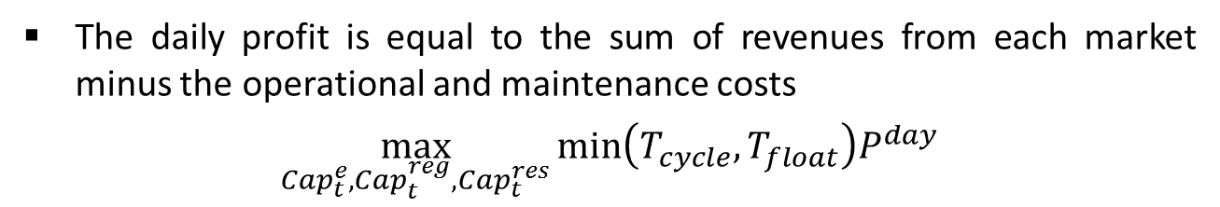
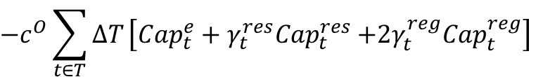
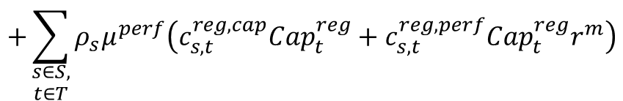
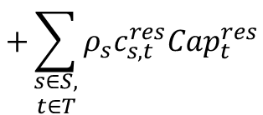
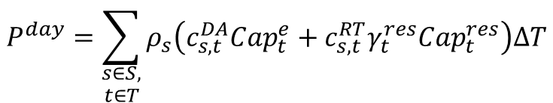
Optimal Bidding in the Joint Power Markets
The daily profit is equal to the sum of revenues from each market minus the operational and maintenance costs
$$\max_{{Cap}_{t}^{e},{Cap}_{t}^{reg},{Cap}_{t}^{res}}{min\left(T_{cycle},T_{float}\right)P^{day}}$$
$$P^{day}=\sum_{\begin{aligned}s∈S, \\ t∈T\end{aligned}}{ρ_{s}\left(c_{s,t}^{DA}{Cap}_{t}^{e}+c_{s,t}^{RT}{γ_{t}^{res}Cap}_{t}^{res}\right)∆T}$$
$$+\sum_{\begin{aligned}s∈S, \\ t∈T\end{aligned}}{ρ_{s}c_{s,t}^{res}{Cap}_{t}^{res}}$$
$$+\sum_{\begin{aligned}s∈S, \\ t∈T\end{aligned}}{ρ_{s}μ^{perf}\left(c_{s,t}^{reg,cap}{Cap}_{t}^{reg}+c_{s,t}^{reg,perf}{Cap}_{t}^{reg}r^{m}\right)}$$
$$−c^{O}\sum_{t∈T}{∆T}\left[{Cap}_{t}^{e}+{γ_{t}^{res}Cap}_{t}^{res}{+2γ_{t}^{reg}Cap}_{t}^{reg}\right]$$
$$−c^{M}P_{max}$$
ECpE Department

Slide 40

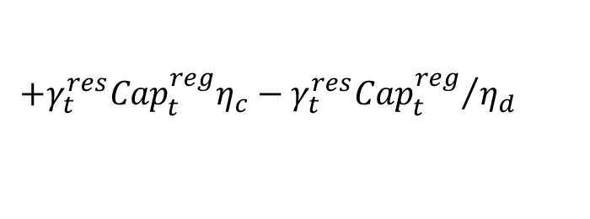
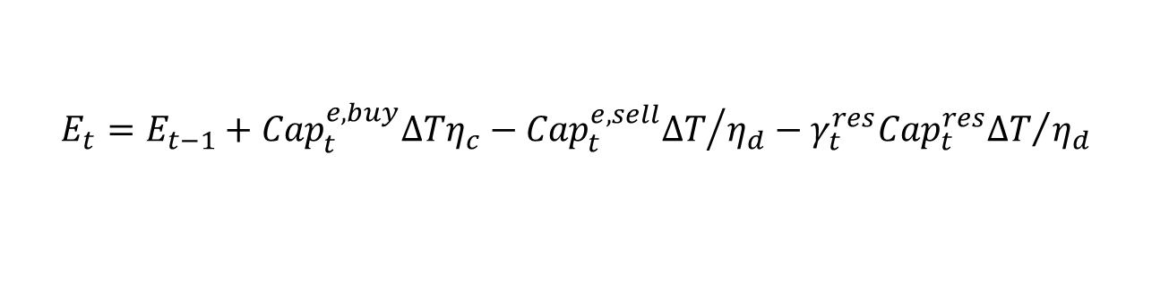
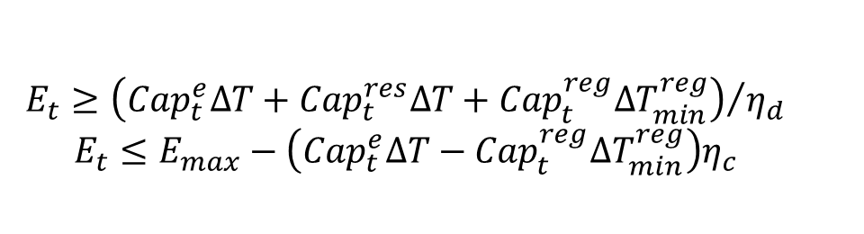

Optimal Bidding in the Joint Power Markets
The operational constrains of the battery storage
Capacity constraints
No ramp constraints for battery ESS
Energy constraints for providing ancillaryy services
State of charge constraints
$${Cap}_{t}^{e}−σ{Cap}_{t}^{reg}≥−P_{max}$$
$${Cap}_{t}^{e}+σ{Cap}_{t}^{reg}+{Cap}_{t}^{res}≤P_{max}$$
$$E_{t}≥{\left({Cap}_{t}^{e}∆T+{Cap}_{t}^{res}∆T+{Cap}_{t}^{reg}{∆T}_{min}^{reg}\right)}/{η_{d}}$$
$$E_{t}≤E_{max}−\left({Cap}_{t}^{e}∆T−{Cap}_{t}^{reg}{∆T}_{min}^{reg}\right)η_{c}$$
$$E_{t}=E_{t−1}+{Cap}_{t}^{e,buy}∆Tη_{c}−{{Cap}_{t}^{e,sell}∆T}/{η_{d}}−{{γ_{t}^{res}Cap}_{t}^{res}∆T}/{η_{d}}$$
$$+{γ_{t}^{res}Cap}_{t}^{reg}η_{c}−{{γ_{t}^{res}Cap}_{t}^{reg}}/{η_{d}}$$
ECpE Department

Slide 41
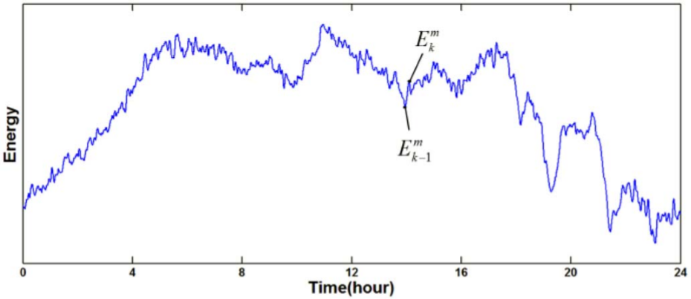

Optimal Bidding in the Joint Power Markets
Battery degradation is considered to calculate the life
Count the cycles based on the extreme points and separate the decision variables from the identification of half cycles.
Model the daily degradation as a power function of depth of cycles
$$T_{cycle}=\frac{1}{α\sum_{k∈K}{d_{half,k}^{kp}}}$$
ECpE Department

Slide 42
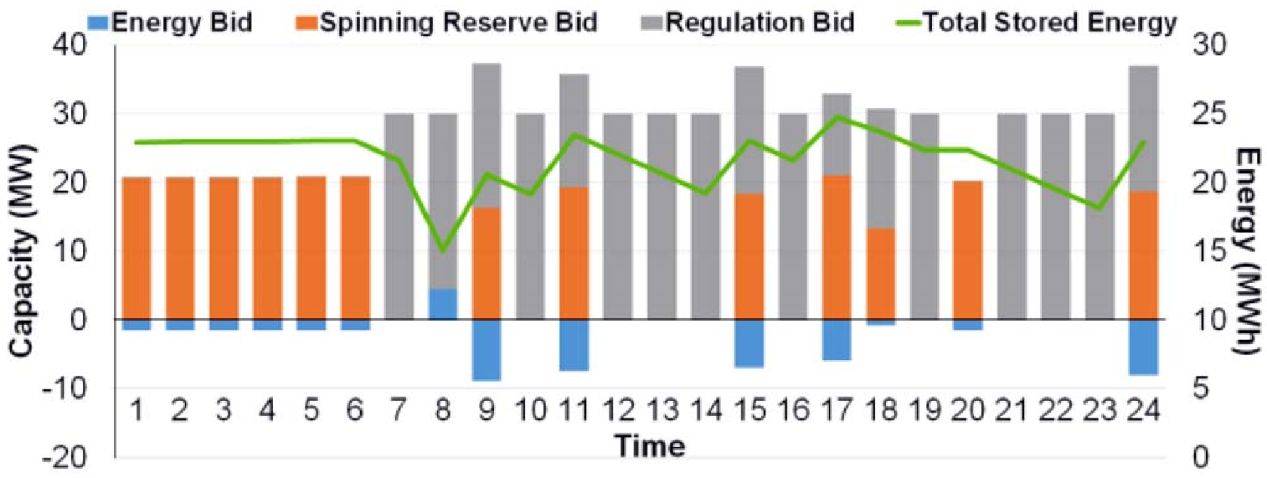
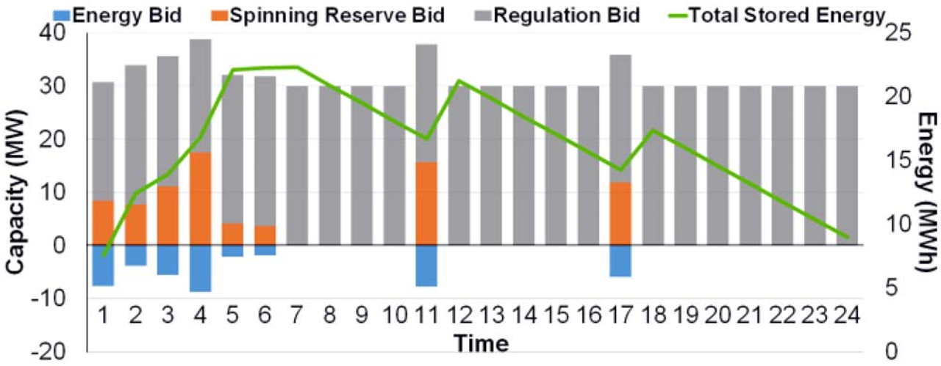
Optimal Bidding in the Joint Power Markets
Optimal bidding strategies and energy curves of battery storage considering cycle life
Optimal bidding strategies and energy curves of battery storage without considering cycle life
ECpE Department

Slide 43
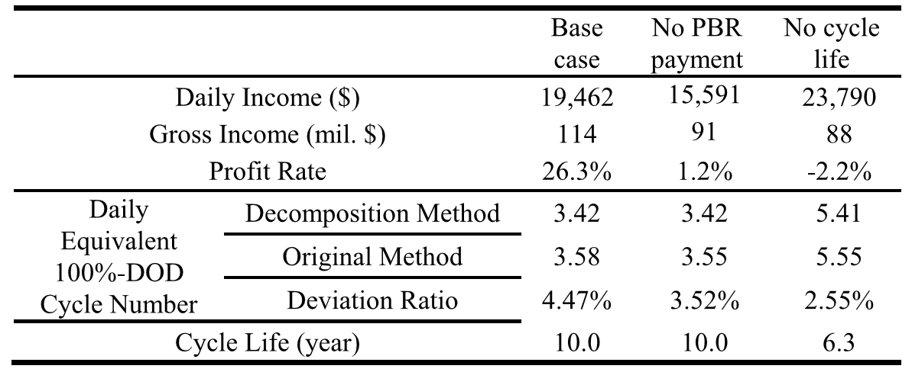
Optimal Bidding in the Joint Power Markets
More advanced probabilistic modeling of volatile price profiles for achieving more effective results.
More accurate modelling method of capacity degradation for incorporating long-term profit into the optimization.
Improved methodology to solve the nonlinear optimization problem considering long-term profit.
[1] He, Guannan, et al. "Optimal bidding strategy of battery storage in power markets considering performance-based regulation and battery cycle life." IEEE Transactions on Smart Grid 7.5 (2015): 2359-2367.
ECpE Department

Slide 44

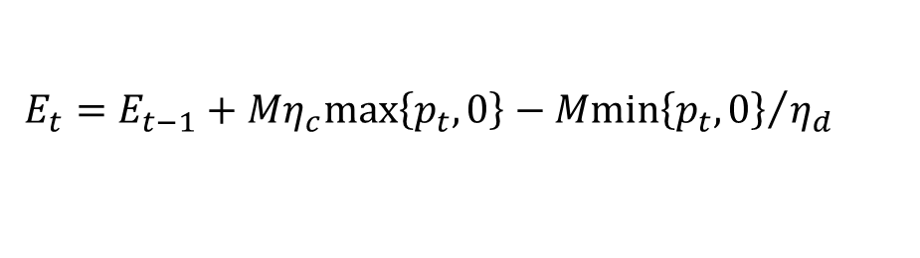


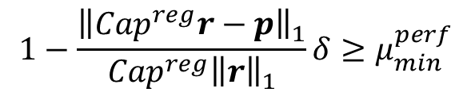
Optimal battery participation in frequency regulation market
If the market clearing price and the regulation signal realization are known, the optimal regulation capacity and dispatch can be obtained by solving
s.t.
$$\max_{{Cap}^{reg},p }{P^{day}\left({Cap}^{reg},p\right)≔\left(1−\frac{{\left\|{Cap}^{reg}r−p\right\|}_{1}}{{Cap}^{reg}{\left\|r\right\|}_{1}}δ\right)}c^{reg}{Cap}^{reg}−A\left(p\right)$$
$$1−\frac{{\left\|{Cap}^{reg}r−p\right\|}_{1}}{{Cap}^{reg}{\left\|r\right\|}_{1}}δ≥μ_{min}^{perf}$$
$$0≤{Cap}^{reg}≤C_{0}$$
$$−C_{0}≤p_{t}≤C_{0}$$
$$E_{t}=E_{t−1}+Mη_{c}max\left\{p_{t},0\right\}−{Mmin\left\{p_{t},0\right\}}/{η_{d}}$$
$$\underline{E}≤E_{t}≤\overline{E}$$
ECpE Department

Slide 45
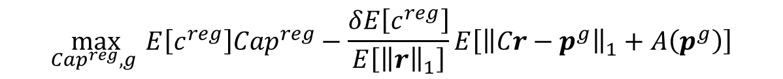
Optimal battery participation in frequency regulation market
However, this problem cannot be solved in real world because the realization is not known in advance.
Therefore, a decision policy need to be determined.
The expected profit corresponding to an operational policy and regulation capacity
By transform the performance requirement into a chance constraint, the initial problem is reformulated as
s.t.
$$J\left(g, {Cap}^{reg}\right)=E\left[P^{day}\left({Cap}^{reg},p\right)\right]$$
$=E\left[\left(1−\frac{{\left\|{Cap}^{reg}r−p\right\|}_{1}}{{Cap}^{reg}{\left\|r\right\|}_{1}}δ\right)c^{reg}{Cap}^{reg}−A\left(p\right)\right]$
$$\max_{{Cap}^{reg},g }{E\left[c^{reg}\right]{Cap}^{reg}−\frac{δE\left[c^{reg}\right]}{E\left[{\left\|r\right\|}_{1}\right]}E\left[{\left\|Cr−p^{g}\right\|}_{1}+A\left(p^{g}\right)\right]}$$
$$Prob\left[1−\frac{{\left\|{Cap}^{reg}r−p\right\|}_{1}}{{Cap}^{reg}{\left\|r\right\|}_{1}}δ≥μ_{min}^{perf}\right]≥ξ; g∈G;{Cap}^{reg}∈\left[0,C_{0}\right]$$
ECpE Department

Slide 46
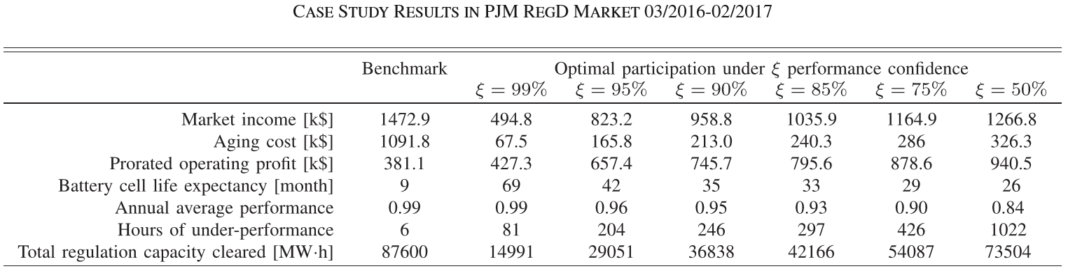
Optimal battery participation in frequency regulation market
The online regulation response policy takes a threshold form to balance the cost of deviating from the regulation signal and the cycle aging cost of batteries while satisfying operating constraints.
The optimal regulation capacity is determined as the minimum between the rated power of the battery and the critical value that exactly guarantee the regulation response satisfy the minimum performance index with a predefined confidence.
[1] Xu, Bolun, et al. "Optimal battery participation in frequency regulation markets." IEEE Transactions on Power Systems 33.6 (2018): 6715-6725.
ECpE Department

Slide 47
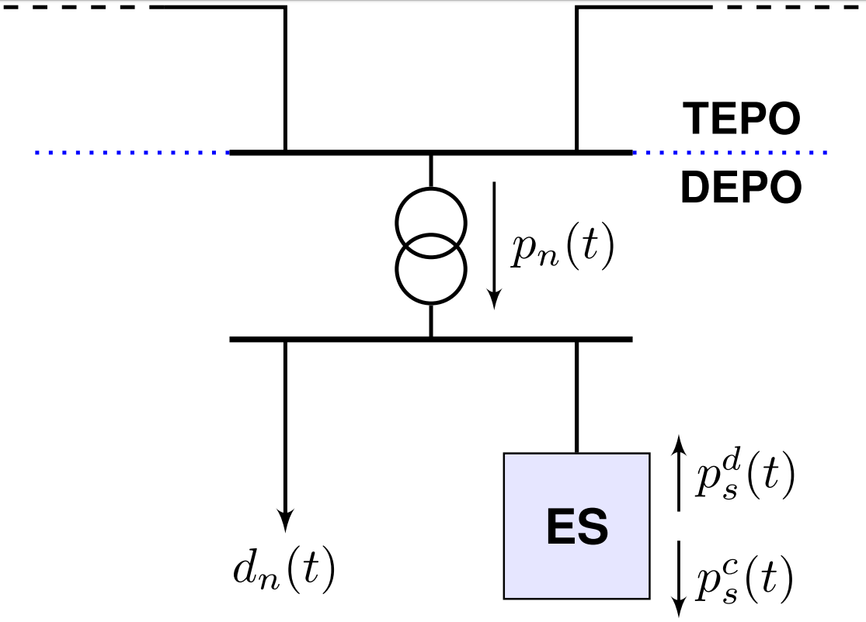
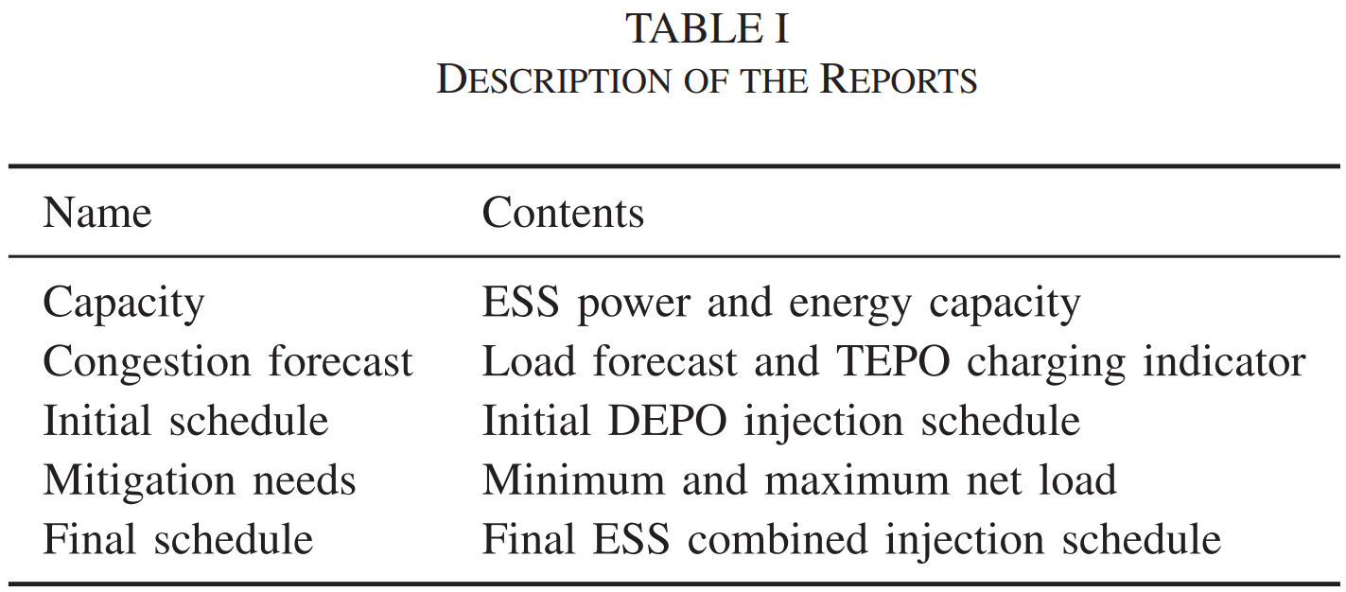
Optimal Battery Dispatch for Transmission Congestion Relief
A more sophisticated multi-level optimization model is proposed to coordinate the transmission congestion with distributive objectives [1].
This model determines the corrective schedule adjustments of ESS and conventional generating units by minimizing their deviations from the initially calculated economic schedules.
[1] R. T. Elliott, R. Fernandez-Blanco, K. Kozdras, J. Kaplan, B. Lockyear, J. Zyskowski, and D. S. Kirschen, “Sharing energy storage between transmission and distribution,” IEEE Transactions on Power Systems, 2018.
ECpE Department

Slide 48
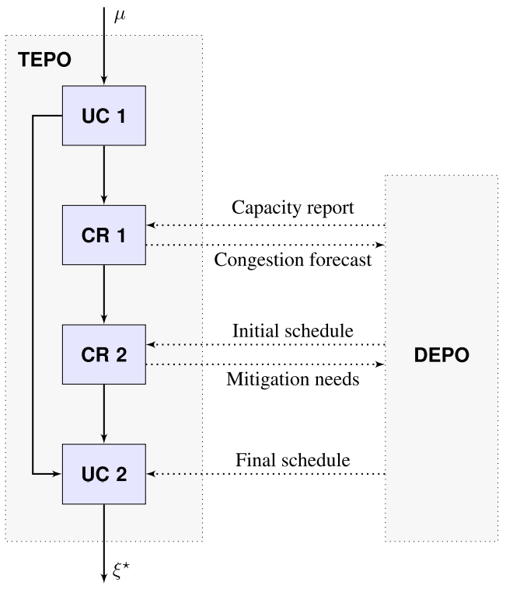

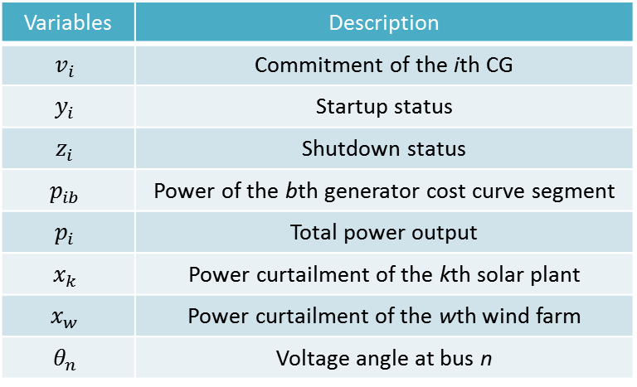
Optimal Battery Dispatch for Transmission Congestion Relief
Stage 1(UC 1), Pre-mitigation unit commitment
In this stage, TEPO solves a standard unit commitment and economic dispatch without considering ESS or system security constraints.
$$ξ:\left(v_{i},y_{i},z_{i},p_{ib},p_{i},x_{k},x_{w},θ_{n}\right)$$
Variables | Description
$$v_{i}$$ | Commitment of the ith CG
$$y_{i}$$ | Startup status
$$z_{i}$$ | Shutdown status
$$p_{ib}$$ | Power of the bth generator cost curve segment
$$p_{i}$$ | Total power output
$$x_{k}$$ | Power curtailment of the kth solar plant
$$x_{w}$$ | Power curtailment of the wth wind farm
$$θ_{n}$$ | Voltage angle at bus n
[1] R. T. Elliott, R. Fernandez-Blanco, K. Kozdras, J. Kaplan, B. Lockyear, J. Zyskowski, and D. S. Kirschen, “Sharing energy storage between transmission and distribution,” IEEE Transactions on Power Systems, 2018.
ECpE Department

Slide 49
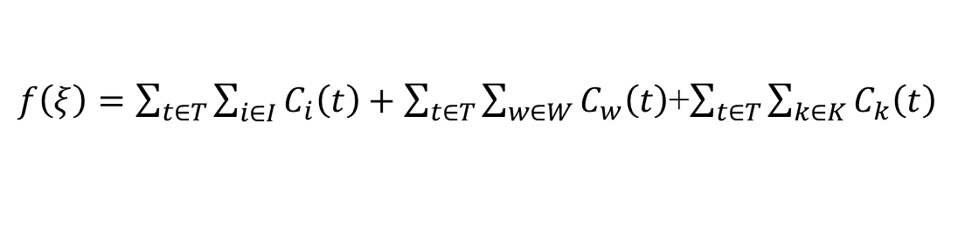
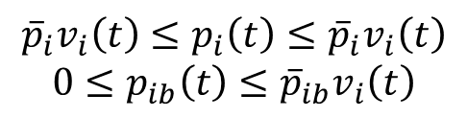
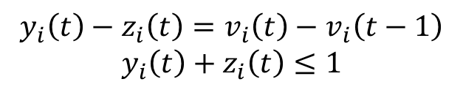
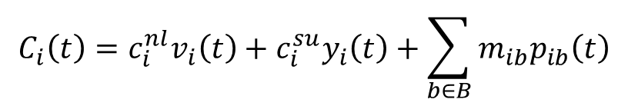
Optimal Battery Dispatch for Transmission Congestion Relief
A standard minimum operating cost objective consisting of three components
The conventional generating costs are given by
Non-load cost + startup cost + bth segment of unit i’s cost curve
Binary variable generation constraints
Power output of each block and the total output is bounded such that
$f\left(ξ\right)=\sum_{t∈T}{\sum_{i∈I}{C_{i}\left(t\right)}}+\sum_{t∈T}{\sum_{w∈W}{C_{w}\left(t\right)}}$+$\sum_{t∈T}{\sum_{k∈K}{C_{k}\left(t\right)}}$
$$C_{i}\left(t\right)=c_{i}^{nl}v_{i}\left(t\right)+c_{i}^{su}y_{i}\left(t\right)+\sum_{b∈B}{m_{ib}p_{ib}\left(t\right)}$$
$$y_{i}\left(t\right)−z_{i}\left(t\right)=v_{i}\left(t\right)−v_{i}\left(t−1\right)$$
$$y_{i}\left(t\right)+z_{i}\left(t\right)≤1$$
$${\overline{p}}_{i}v_{i}\left(t\right)≤p_{i}\left(t\right)≤{\overline{p}}_{i}v_{i}\left(t\right)$$
$$0≤p_{ib}\left(t\right)≤{\overline{p}}_{ib}v_{i}\left(t\right)$$
[1] R. T. Elliott, R. Fernandez-Blanco, K. Kozdras, J. Kaplan, B. Lockyear, J. Zyskowski, and D. S. Kirschen, “Sharing energy storage between transmission and distribution,” IEEE Transactions on Power Systems, 2018.
ECpE Department

Slide 50




Optimal Battery Dispatch for Transmission Congestion Relief
Ramp constraints
${\underline{R}}_{i}≤p_{i}\left(t\right)−p_{i}\left(t−1\right)≤{\overline{R}}_{i}$
Power transfer throughout the transmission network is modeled using a standard dc power flow approximation
The nodal power balance constraints can be stated as
$$F_{i}\left(t\right)={\left[θ_{o\left(l\right)}\left(t\right)−θ_{d\left(l\right)}\left(t\right)\right]}/{x_{l}}$$
$$d_{n}\left(t\right)=\sum_{i∈I_{n}}{p_{i}\left(t\right)}+\sum_{j∈J_{n}}{p_{j}\left(t\right)}+\sum_{k∈K_{n}}{{\hat{p}}_{k}\left(t\right)}$$
$$+\sum_{k∈W_{n}}{{\hat{p}}_{w}\left(t\right)}−\sum_{l∈O_{n}}{F_{l}\left(t\right)}+\sum_{l∈D_{n}}{F_{l}\left(t\right)}$$
[1] R. T. Elliott, R. Fernandez-Blanco, K. Kozdras, J. Kaplan, B. Lockyear, J. Zyskowski, and D. S. Kirschen, “Sharing energy storage between transmission and distribution,” IEEE Transactions on Power Systems, 2018.
ECpE Department

Slide 51


Optimal Battery Dispatch for Transmission Congestion Relief
Stage 2(CR 1), independent congestion relief
In this stage, TEPO solve an optimization with the capacity report to determine a minimal set of corrective actions required to alleviate congestion.
Cardinality minimization is a NP-hard in general, but it is equivalent to $l_{p}$-norm minimization, $l_{1}$-norm is used as a convex approximation to the carnality function.
$$f\left(ξ\right)=\sum_{r∈R}{\left|α_{r}ξ_{r}\right|}={\left\|Aξ\right\|}_{1}$$
[1] R. T. Elliott, R. Fernandez-Blanco, K. Kozdras, J. Kaplan, B. Lockyear, J. Zyskowski, and D. S. Kirschen, “Sharing energy storage between transmission and distribution,” IEEE Transactions on Power Systems, 2018.
ECpE Department

Slide 52

Optimal Battery Dispatch for Transmission Congestion Relief
In addition to the constraints in stage 1, the transmission power and energy storage constraints are introduced
In Stage 3(CR 2), TEPO solves an optimization with the consideration of DEPO’s proposed ESS schedule. The formulation is nearly the same as in stage 2, except changing the ESS output power penalty function.
TEPO sends DEPO the mitigation needs report. Based on this information, DEPO computes and returns the final ESS schedule.
$${\underline{F}}_{l}≤F_{l}\left(t\right)≤{\overline{F}}_{l}$$
$$0≤p_{s}^{c}\left(t\right)≤{\overline{p}}_{s}^{c}v_{s}\left(t\right)$$
$$0≤p_{s}^{d}\left(t\right)≤{\overline{p}}_{s}^{d}\left(1−v_{s}\left(t\right)\right)$$
${\overline{E}}_{s}≤E_{s}\left(t\right)≤$ ${\underline{E}}_{s}\left(t\right)$
$E_{s}\left(t_{f}\right)$= $E_{s}^{′}$
[1] R. T. Elliott, R. Fernandez-Blanco, K. Kozdras, J. Kaplan, B. Lockyear, J. Zyskowski, and D. S. Kirschen, “Sharing energy storage between transmission and distribution,” IEEE Transactions on Power Systems, 2018.
ECpE Department

Slide 53


Optimal Battery Dispatch for Transmission Congestion Relief
Stage 4, Post-Mitigation Unit Commitment
This problem treats the ESS injection schedules determined in Stage 3 as inputs and solves for the least-cost generation schedule considering ESS injections and transmission capacity constraints.
[1] R. T. Elliott, R. Fernandez-Blanco, K. Kozdras, J. Kaplan, B. Lockyear, J. Zyskowski, and D. S. Kirschen, “Sharing energy storage between transmission and distribution,” IEEE Transactions on Power Systems, 2018.
ECpE Department

Slide 54
Thank you!
ECpE Department

